Slide 1
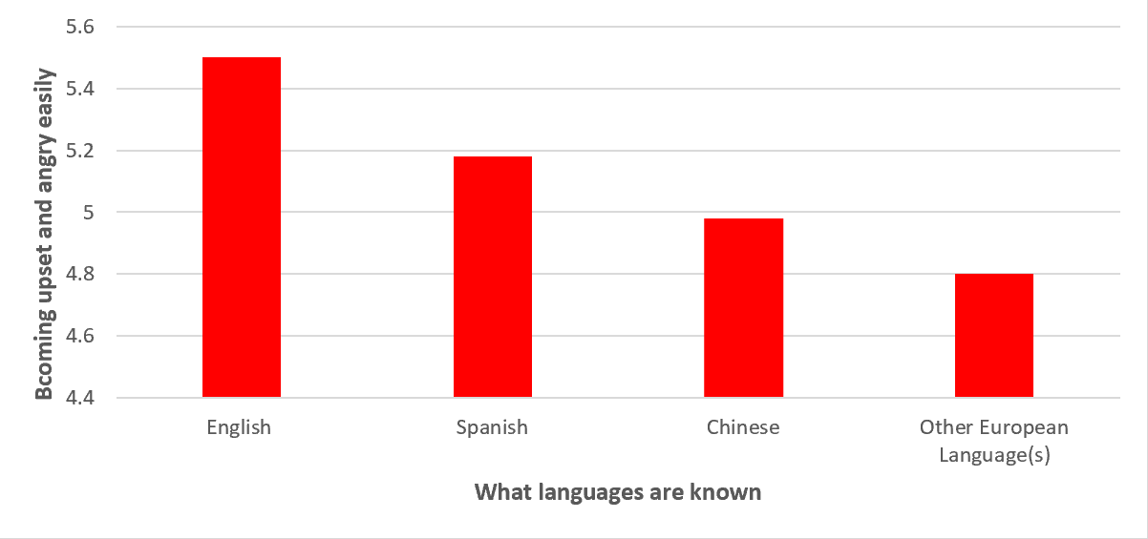
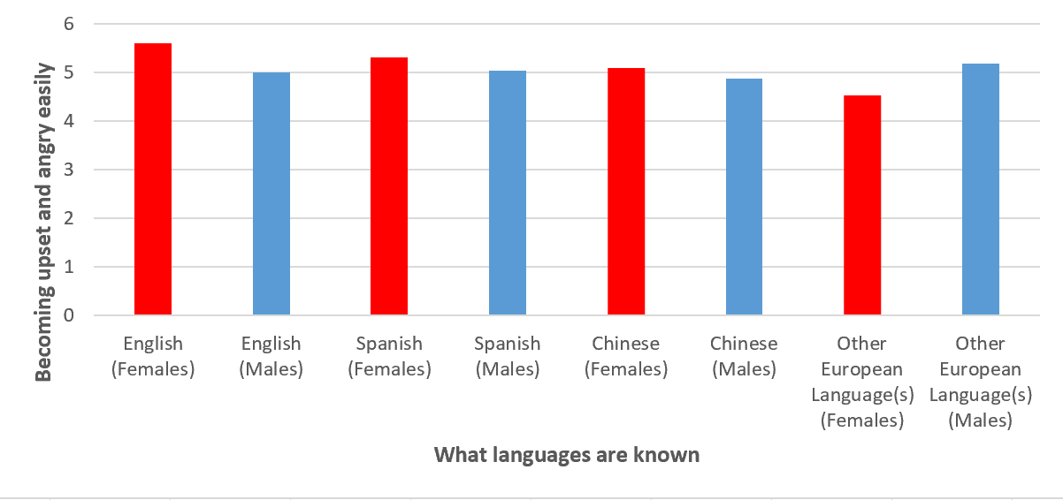
The Association between Parent-Child Relationships and Multilingualism in Adults in the United States
Laci Dezern
Research Mentor: Dr. Kristel M. Gallagher
Research Questions
Method
Results
Discussion
Is there an association between multilingualism across the lifespan and dominating personality traits in parents?
Is there a connection between a strained (not abusive) parent-child relationship and being in a multilingual home?
Measures
The variables used in this research study include:
What language do you speak to your child(ren) when you are together at home?
-The participants responded from a list ranging from 1-7, each number representing a different language.
A secondary variable created to represent how many participants became upset and/or angry easily with the following survey questions:
I get upset easily. The respondents were given a choice of 1 (strongly disagree) through 5 (strongly agree).
I get angry easily. The respondents were given a choice of 1 (strongly disagree) through 5 (strongly agree).
A secondary variable created to represent if parents are overwhelmed and/or stressed by their children with the following questions:
The major source of stress in my life is my child(ren). The respondents were given a choice of 1 (strongly disagree) through 5 (strongly agree).
I feel overwhelmed by the responsibility of being a parent. The respondents were given a choice of 1 (strongly disagree) through 5 (strongly disagree).
Univariate Statistics
The mean number of times participants reported becoming upset and angry easily was 5.15 with a standard deviation of 1.83 and a range of “strongly disagree” (1) to “strongly agree" (5). A minority of participants reported that it was easy for them to become upset and angry.
95% of parents speak one language to their children at home, where 5% report they speak two or more languages to their children at home.
86% of respondents reported that they spoke English. 13% of people reported they spoke Spanish.
Bivariate Statistics
An ANOVA test was conducted to examine the relationship between being multilingual and becoming upset and angry at one’s children easily. The test was significant, F(5102)=2.81, p=0.0381. This indicates that those who are multilingual have a greater probability of easily becoming upset and angry at their children.
A Correlation test was conducted to examine the relationship between hours worked and languages spoken. The test was significant, r=(5023)=.02, p=0.05. This indicates that people who work more hours tend to speak more than one language.
Multivariate Statistics
Gender was found to be a moderating variable in the relationship between how many languages a person knew, and how easily they were to become upset and angry. The original ANOVA test between these two variables' relationship was significant (see Figure 1), The test was significant females as well (p=.04). However, it was not significant for males (p=5.4). This determined that gender is a moderating variable.
The results of this study suggests that there is a possible correlation between being multilingual and having domineering personality traits.
There is a definite association that being multilingual at home may strain parent-child relationships.
There is a difference between men and women; females who are multilingual have a greater chance of becoming upset and angry.
These findings can be used in the real world to find parents who may be struggling with these circumstances and provide them with emotional help should they want it.
Counselors may find this information useful to formulate new knowledge of and better help this group of people.
Future research could determine why stress levels of multilingual parents are higher than those who speak one language.
Background Research
According to Gosselin-Lavoie and Armand (2019), children who speak the school language more often than their home language are more likely to learn their home language more fluently. This change helps encourage and positively influence families of the child learning the school language. Children who learn another language typically do so to fit in within social groups, to conform, and are enticed through socio-political influences.
According to Lopez and Shen (2021), children who have a higher-grade point average, are bilingual, and have a decent relationship with their parents possess higher self-esteem and a decrease of social problems at school. Likewise, bilingualism can decrease the effects of social discrimination. However, children who endure conflicts with their parents tend to have lower self-esteem.
According to Rodriguez (2008), many parents that are Hispanic or have Spanish origins tend to expressive more negative emotions than other cultural familial groups. Hispanic people may use parent dissatisfaction as a reason for disciplinary parenting. However, high school graduates of all cultural backgrounds felt better about their parenting skills, received lower child-abuse scores, and had more social and economic support resources. Yet, parents who tend to express anger more often tend to show higher risk for child-abuse tendencies.
References
Gosselin-Lavoie, C., & Armand, F. (2019). Use of bilingual albums by bi/plurilingual families: Description of the languages ​​used during readings and interactions. Canadian Modern Language Review, 75 (2), 105-127.
Lopez, A., & Shen, C. (2021). Predictors of self-esteem among Mexican immigrant adolescents: An examination of well-being through a biopsychosocial perspective. Child & Adolescent Social Work Journal, 38 (3), 347-358.
Rodriguez, C. M. (2008). Ecological predictors of disciplinary style and child abuse potential in a Hispanic and Anglo-American Sample. Journal of Child & Family Studies, 17 (3), 336-352.
Figure 1. Correlation between languages spoken and becoming upset and angry easily at one’s children.
Figure 2. Correlation between languages spoken and becoming upset and angry easily at one’s children for both males and females.
Research conducted and presented as part of the Passion Driven Statistics course at Thiel College in Fall 2022.
Method
Sample
This project utilized secondary data analysis to answer the research questions. The data was drawn from a publicly available sample of respondents from Wave IV of the National Longitudinal Study of Adolescent to Adult Health (Add Health). Add Health is a nationally representative sample of adults living in all 50 states of the United States. Wave IV was collected in 2008 and contains 5,114 respondents aged 25-34 years. Of those, 46% are male and 54% are female. The race breakdown includes approximately 72% white, 24% black or African American, 1% American Indian or Alaska Native, and 3% Asian or Pacific Islander.

