Slide 1
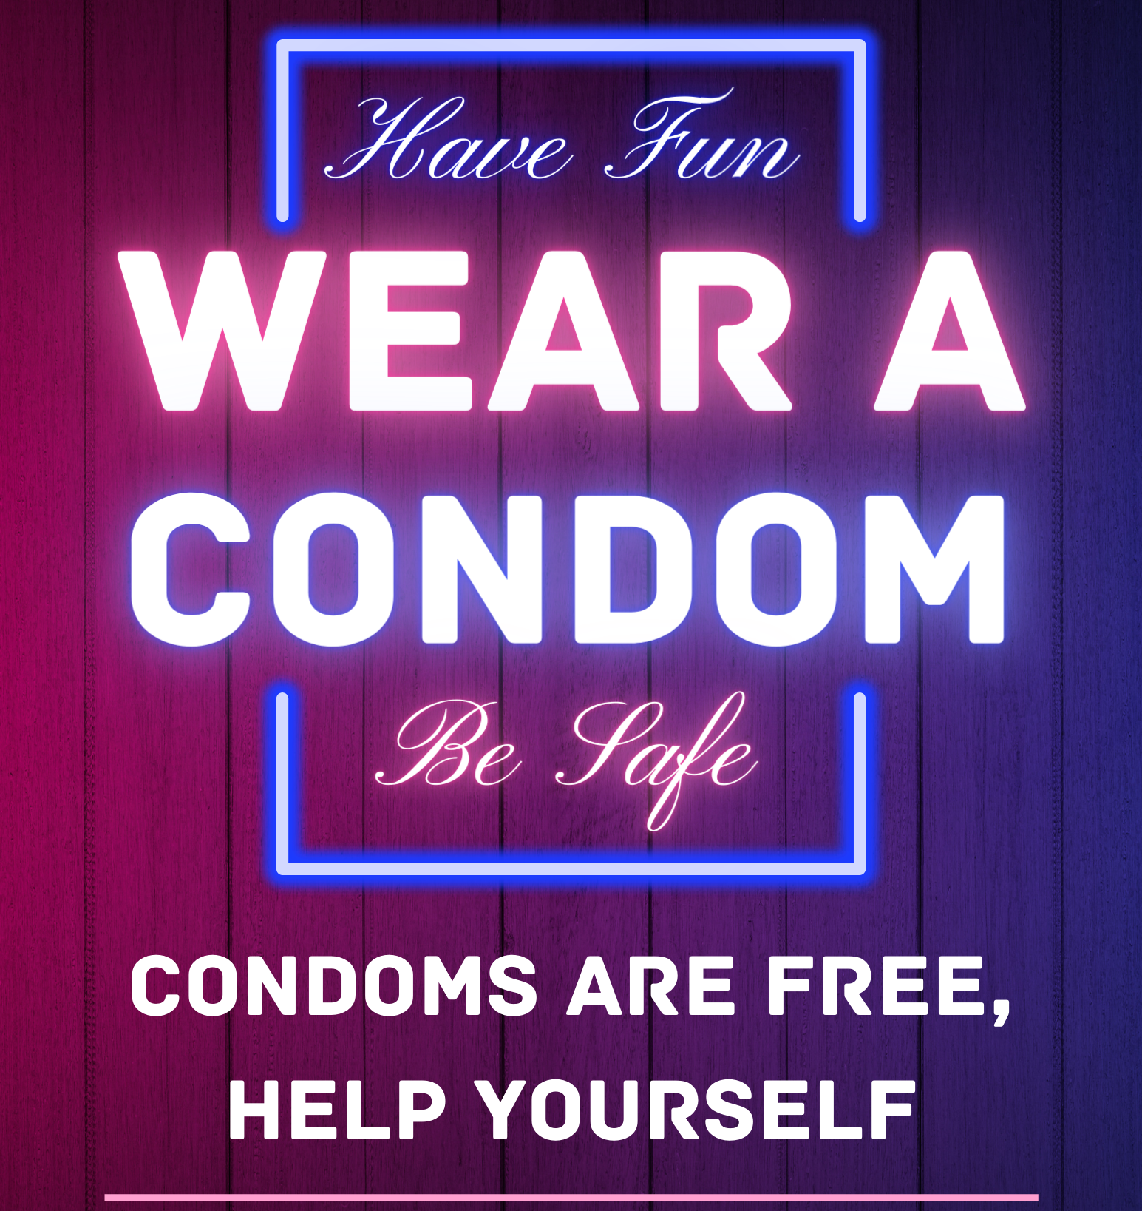
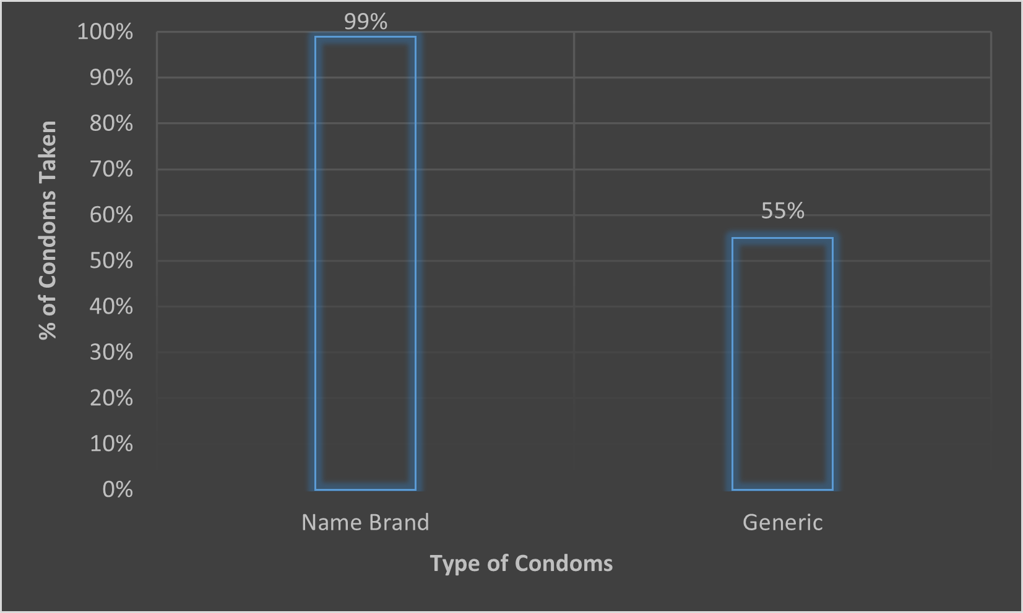
Students, and Brand Names, and Condoms, Oh My!
Students were more likely to take name brand condoms than generic condoms.
RESULTS
An independent samples t-test was computed to assess the effect of the type of condoms available on the number taken (expressed as a percentage of total condoms available). There was a significant effect of the type of condoms on the number taken, t(28)=5.036, p<.001, with the name brand group and the generic group having significantly different mean values. The mean percent of condoms taken for the name brand group was 98.67% (SD=5.16%), while the mean percent of condoms taken for the generic group was 55.33% (SD=32.92%).
Michaela Brown
Research Mentor: Dr. Gallagher
INTRODUCTION
Throughout my years in college, I have heard students call generic (less recognized) brands of condoms “cheap” and say that they should not be used. So, I turned this observation into a research project.
Williams et al. (2001) conducted a study on providing a variety of condom brands to patients at two different clinics. The researchers found that when there were multiple brands of condoms provided, more were taken.
One study showed that even when presented with identical items, participants still preferred the ones labeled with a name brand. Skaczkowski et al. (2018) studied the influence of cigarette brand names on the smoking experience. After smoking two identical cigarettes, participants rated the one labeled as a name brand more favorably and less stale. This study shows that someone’s perception of a name brand can impact their experience with products.
My research examined whether name brand condoms would be taken more frequently than generic condoms by students when offered for free. I hypothesized that students would show a preference for the name brand condoms.
Figure 1. Correlation between type of condom and the percentage taken.
DISCUSSION
Students were more likely to take name brand condoms than generic condoms when they were provided for free.
A major limitation to this study was being able to fund it. I was not able to buy enough condoms to do a full week of research. Students took more condoms than anticipated when purchasing supplies, so the name brand condoms rapidly ran out.
Some future directions for this research would be to determine if the cost of supplying name brand condoms is offset by the benefits this would provide. Further research should be done to determine if supplying name brand condoms actually increases safe sex practices among students.
METHOD
Participants
6 upperclassman dorm floors on college campus
~292 participants, both male and female
Materials
Trojan condoms
Generic condoms
Clear bins, flyers, and tape
Procedure
3 floors randomly assigned name brand & 3 floors randomly assigned generic condoms
10/5 condoms placed in bins on each floor, along with flyers (see image to the right)
Condoms counted and replenished every night for 5 days
REFERENCES
Skaczkowski, G., Durkin, S., Kashima, Y., & Wakefield, M. (2018). Influence of premium vs masked cigarette brand names on the experienced taste of a cigarette after tobacco plain packaging in Australia: An experimental study. BMC Public Health, 18(1), 1-10. https://doi.org/10.1186/s12889-018-5200-8
Williams, J. L., Christensen, C. J., Cagle, H. H., Homan, C. E., Williams, J. L., Christensen, C. J., Cagle, H. H., & Homan, C. E. (2001). Brief report on the effect of providing single versus assorted brand name condoms to hospital patients: A descriptive study. BMC Public Health, 1(1), 1-5, https://doi.org/10.1186/1471-2458-1-5

